Slide 1
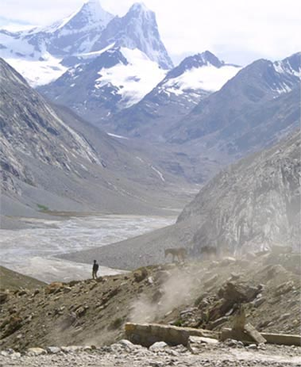
Fellowship of the Heart
Getting Started — the Four Connects, walked around the table on alternating evenings
Evening Series 2026–27 · at the Tittle home · v1.5E DRAFT
All Scripture: ESV · The Companion lesson plans carry the full scripts — these slides carry the room
1
Notes:
DECK TITLE · pre-session · DIVIDER
On screen as the room assembles on night one. All Scripture ESV; the plans carry the scripts; these slides carry the room — and these notes carry you.

Slide 2

SESSION 11
Any Doubts?
Bringing the real question, and bringing it to God
Quarter 2: Connect with God
138
Notes:
S11 · pre-session · DIVIDER
On screen through dinner and as the circle forms. Greet at the door — the slide holds the room.

Slide 3
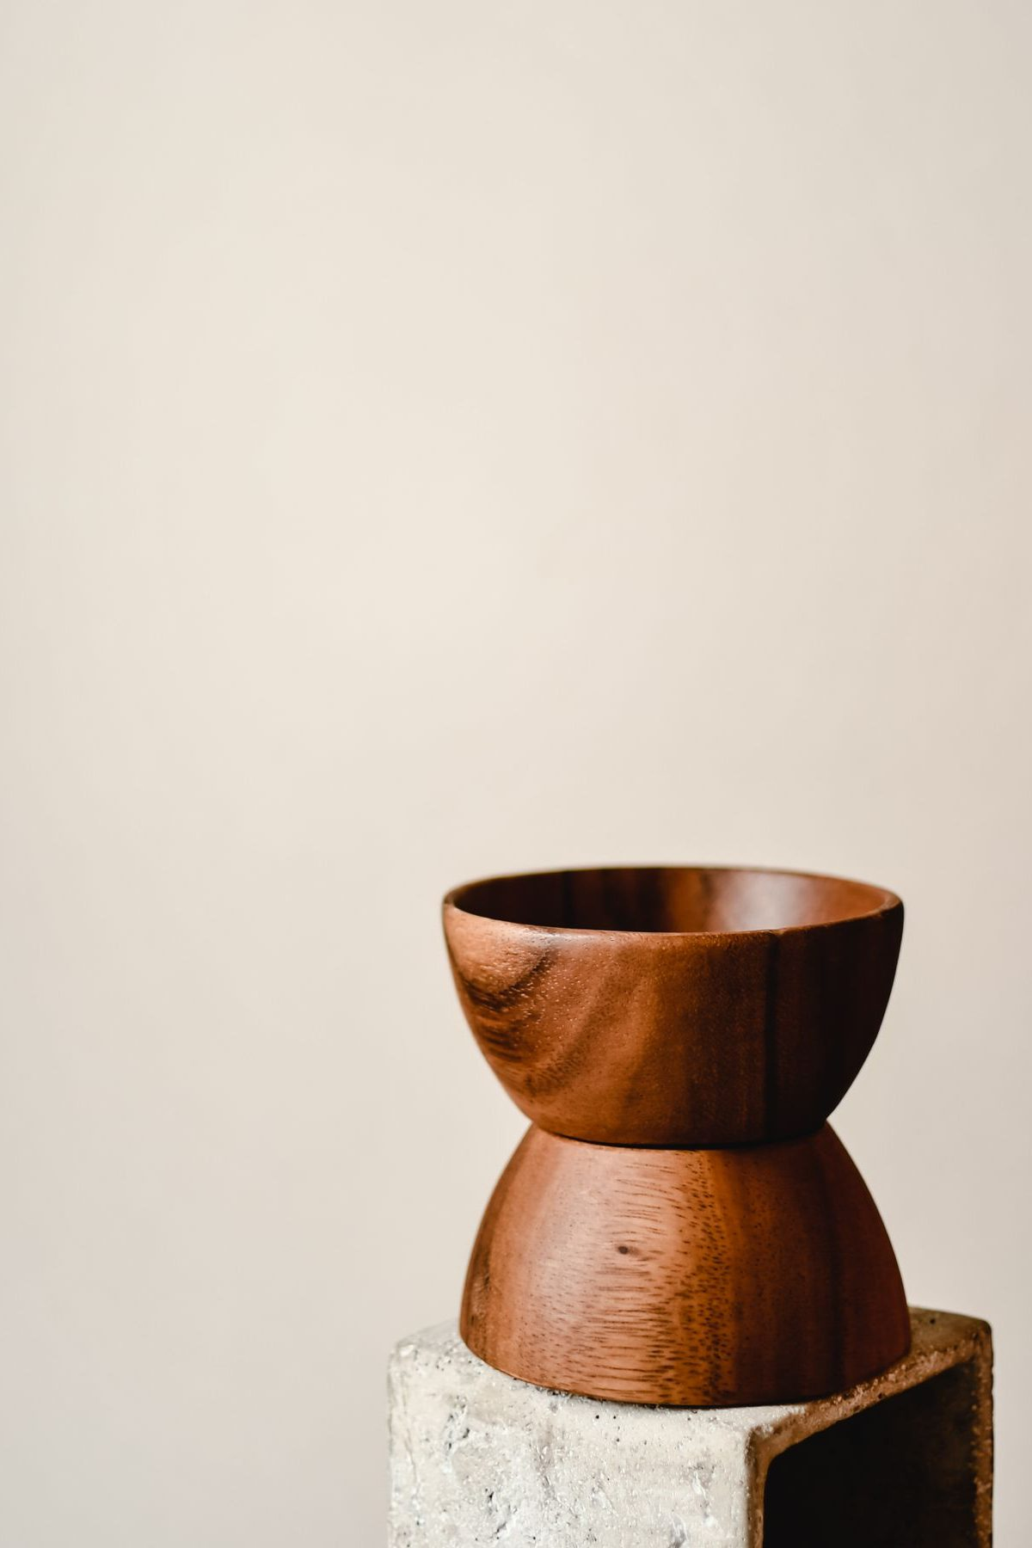
Session 11 — Tonight’s Road
1 Welcome and centering
2 Week 9 check-in
3 Mark 9:14–29 — the scripture ground
4 The Any Doubts? practice — teaching
5 Bridge to split
6 Any Doubts? in pairs within families
7 Merge and surface
8 Homework commissioning — handout + check-in partners
9 Leader Feedback Round
10 Closing container
139
Notes:
S11 · 7:00–7:08 · LEAD: CONTAINER HOLDER
BEATS: 1. Week 11 — last gathering of the quarter and the exact midpoint of the year: eleven evenings behind, eleven ahead. 2. Today: Any Doubts? — bringing the small quiet doubts we never say aloud, honestly, to God, in front of one other person. 3. With the Garden, one of the two highest-confidence practices in this whole body of work — treat it with care. 4. Frame it early and repeat it: doubt is not disbelief; this is the gap between what we say and what we actually trust.

Slide 4
Opening Container — the Eight Steps
1 Welcome — five minutes to open the container
2 Phones silenced and put away
3 Stand in a circle
4 One-word check-in — how you actually are, right now
5 Put out / bring in — set something down; bring a blessing in
6 Spoken commitment: “I am here. I am paying attention. I am willing to be moved.”
7 Opening prayer — “Holy Spirit, you are welcome here. Speak. We are listening.”
8 Sit. Begin.
140
Notes:
S11 · 7:00–7:08 · LEAD: CONTAINER HOLDER
BEATS: 1. 'Welcome back. Settle.' Aaronic blessing. 2. Name the night: this goes against most of what we have been taught about how spiritual people should sound — we bring our actual doubts and bring them honestly to God. 3. Container: what is said in your pair stays in your pair; nothing is required; specificity is the practice, honesty is the goal.

Slide 5

Week 9 Check-In — the Garden Returns
• The practice was three returns to the garden
• “Anyone want to say one sentence about how that went — the garden visits, or what surfaced, or that you didn’t get to it?”
• One sentence each, voluntary — received without commentary
– “Good. The garden is still there. You can return any time. We continue.”
141
Notes:
S11 · 7:08–7:25 · LEAD: CONTAINER HOLDER
BEATS: 1. One sentence on the garden returns — how it went, what surfaced, or that you didn't get to it. 2. Take 2–3 voluntary contributions; receive without commentary. 3. Move on with: 'Good. The garden is still there. You can return any time. We continue.'
CUES: Arranged parent opens (check the Run Card) — never cold-call a teen; pass-anytime holds.

Slide 6

Mark 9:14–29 — the Scripture Ground
• The whole scene, read slowly — the desperate father, the failed disciples, the boy in convulsions
• He does not pretend the unbelief is not there — he names both at once. And Jesus does not rebuke him; Jesus heals the boy
• The unbelief that is named and brought to Jesus is the unbelief that can be released; suppressed, it works as a quiet brake
• Tonight is not generating new doubts — it is bringing the ones already there into the open, and bringing them to Jesus
MARK 9:24
“Immediately the father of the child cried out and said, ‘I believe; help my unbelief!’”
142
Notes:
S11 · 7:25–7:33 · LEAD: CONTENT PRESENTER
BEATS: 1. Read Mark 9:14–29 IN FULL from the physical Bible, slowly, without stopping to comment — the verse lands differently inside the whole scene. 2. Teach the model: the father names belief and unbelief at once — 'I believe; help my unbelief' — and Jesus does not rebuke him; He heals the boy. 3. Most of us say the believing half loud and bury the unbelieving half, where it works as a quiet brake on faith. 4. Today is not generating new doubts — it is bringing the unbelief already there into the open, and bringing it to Jesus.

Slide 7

The Any Doubts? Practice — Four Steps
1 NAME — the scripture, then the doubt. Specific, not abstract: “I doubt He hears prayer about this specific thing”
2 EXAGGERATE — make the doubt bigger, not smaller. You are not endorsing it; you are exposing it
3 SIT — what does the doubt feel like in your body? Ten or fifteen seconds. Don’t fix it. Feel it
4 RE-READ — your partner reads the same scripture again, slowly. The Spirit does the work; you do the noticing
• Watch the demo — specific, honest, brief, and unresolved-but-honest is the gift
143
Notes:
S11 · 7:33–7:41 · LEAD: CONTENT PRESENTER
BEATS: 1. Callback, 30s: journals open to the first-night question — naming a doubt takes the same courage. 2. The seat for the skeptic, named ALOUD: a doubt bigger than today's list is welcome and has its own standing door — any Companion, any week, for as long as it takes. 3. Whiteboard walk: NAME (specific, not abstract) / EXAGGERATE (expose the brake, not endorse it) / SIT (feel it, 10–15s) / RE-READ (the Spirit works; you notice). 4. Demo with a Co-Companion, 3 min — real scripture, real small doubt; do NOT resolve it at the end. The pairs calibrate everything against this demo.
CUES: Keep the demo brief — do not let teaching eat the pair time.
SUB: Demo YOUR OWN real, small doubt — never fake one, never borrow the founder's. If you cannot bring one honestly, walk the four steps only and let the arranged parents' first turns carry the modeling.

Slide 8
Bridge to the Split — Parents First
• Take the practice card from your chair — Name · Exaggerate · Sit · Re-read. Pairs form within your own family, a parent with their own teen
• In every pair the parent goes first — arranged this week; nobody is being put on the spot tonight
– “Teens: you go second, and you choose your own depth. A small doubt is enough. Passing is enough.”
• No scripture in mind? Pick one with a flicker for you, not a hurricane
– Romans 8:28 · Jeremiah 29:11 · Psalm 139:13–16 · John 14:1–3 · Romans 8:38–39 · James 1:5
• Partners: read, listen, re-read. Not fix. Not theologize. “We are not arguing the doubt. We are bringing it.”
144
Notes:
S11 · 7:41–7:43 · LEAD: CONTENT PRESENTER · TRANSITION
BEATS: 1. Practice card H11.1 goes with them. Pairs are announced by the leadsanion — pre-considered, within families, parent with own teen; never improvised on the night. 2. Say it plainly: in every pair the PARENT goes first — arranged this week; Mark 9:24 is a parent's sentence first. Teens go second and choose their own depth; a small doubt is enough; passing is enough. 3. Scripture choice: a flicker, not a hurricane — H11.3 has options. 4. Partners: read, listen, re-read — never fix, never theologize. Pray and send.

Slide 9
Any Doubts? in Pairs, within Families
1 Pick a scripture; your partner reads it slowly — from the physical Bible if possible
2 “What I notice is ___. The doubt I am holding is ___.” — specific
3 Exaggerate it, then sit with the feeling for 10–20 seconds
4 “Read it again, please.” Then: “What I notice this time is ___.”
• The parent’s turn first, then switch — the teen at their own depth; pass-anytime holds
• Two agreements: you are not arguing or fixing the doubt — and nothing leaves your pair
145
Notes:
S11 · 7:43–8:14 · LEAD: CONTENT PRESENTER · PAIRS
BEATS: 1. Thirty minutes: one full cycle each direction, about 7 min per turn, parent's turn first; partial second cycle if time allows. Companion calls switches at seven minutes; never interrupt a re-read. 2. The turn: partner reads; 'the doubt I am holding is ___'; gentle exaggerate; sit 10–20s; re-read; 'what I notice this time is ___'. 3. Interventions: apologetics — 'we're not arguing the doubt'; no doubt found — honest, run the partner's cycle; exaggeration won't come — don't push; distress — stop the exaggeration, re-read, sit with them.
GUARD: The practice never runs on a scripture the person actively rejects — flicker, not hurricane. A parent's doubt about the very teen across from them moves to a different doubt today and a 1:1 later. Anything bigger than the exercise: bless the naming, end the cycle gently, follow up within 48 hours.

Slide 10
Merge and Surface
• What happened in your pair stays in your pair — no one will be asked to share a doubt or a scripture
• “One word about what the practice was like. Not the doubt — the practice.”
– “Surprising.” “Heavy.” “Quiet.” “Awkward.” “Honest.” “Lighter.” Pass anytime
• This practice fits in five minutes alone, or twenty with a friend — a way of bringing your real questions to God for the rest of your life
• “The resolution is the Spirit’s work. The naming is yours. We do the naming. He does what only He can.”
146
Notes:
S11 · 8:14–8:20 · LEAD: CONTENT PRESENTER
BEATS: 1. What happened in your pair stays in your pair — not back to the pair, not around the dinner table, unless the one who named it brings it up first. 2. One word about the practice, not the doubt: 'surprising', 'heavy', 'honest', 'lighter'. Receive with a nod; no commentary. 3. Two closers: this practice takes five minutes alone, for the rest of your life; and the naming is ours — the resolution is the Spirit's work.
CUES: Pass-anytime holds. Watch faces — follow up offline within 48 hours on anything the night stirred.

Slide 11

Homework — Two Weeks, Four Parts — the Doubts Inventory
• The Personal Doubts Inventory — twenty minutes with your journal, once this week
1 List 5–10 scriptures you say you believe; rate your honest trust, 1–5
2 For the two or three with the most hesitation — write the specific doubt, then sit with it
• No shame. Just data. Yours alone — never turned in, never seen by the team
• The Quarterly Pulse goes home tonight — three questions, five minutes, honest. Back in the bin at The Return’s door in January
• Over the break: keep one practice alive — just one, your choice
147
Notes:
S11 · 8:20–8:24 · LEAD: CONTENT PRESENTER
BEATS: 1. Personal Doubts Inventory (H11.2): twenty minutes once this week — list 5–10 scriptures you say you believe, rate your honest trust in each, and write one specific sentence on the 2–3 lowest. No shame, just data; nobody ever sees it. 2. Hand out the Quarterly Pulse (H11.4): three questions, five minutes at home, honest — back in the bin at The Return's door in January. 3. 'Body in the room, mind on the mortgage' is exactly the kind of answer the page is for.

Slide 12
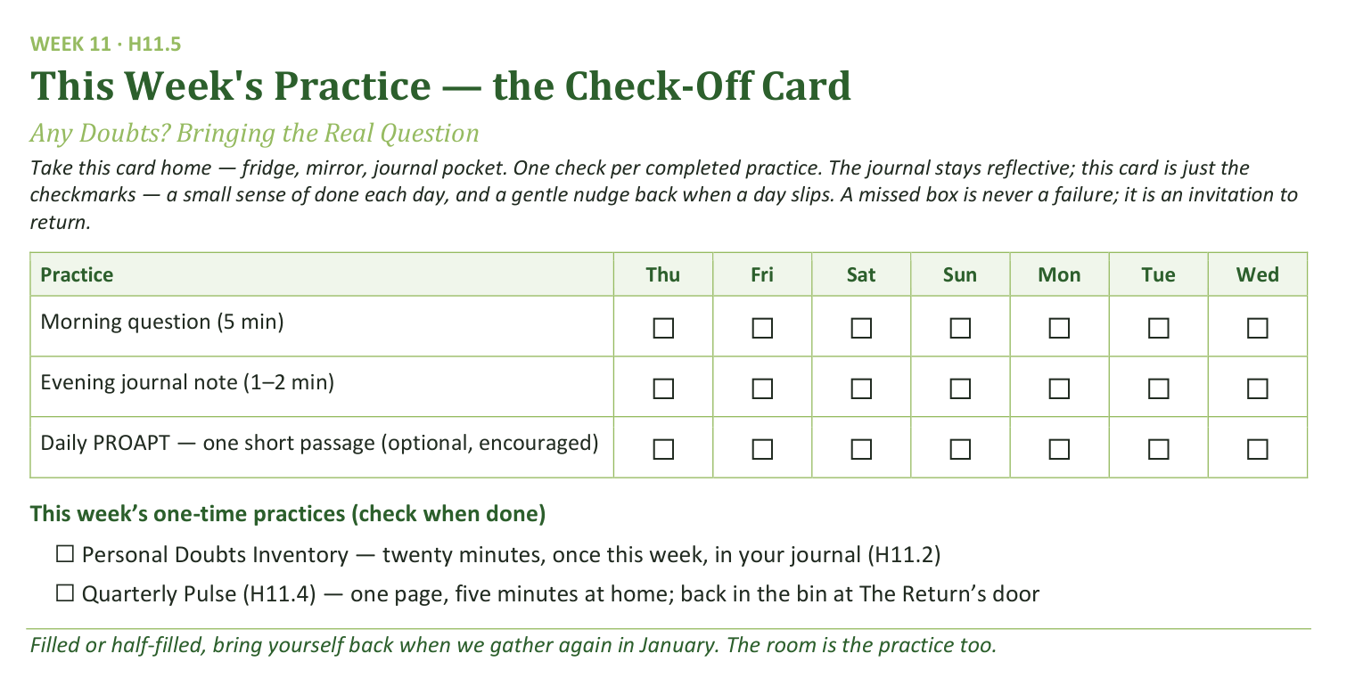
Your Take-Home Card — This Session’s Practice
Handed out now — fridge, mirror, journal pocket.
148
Notes:
S11 · 8:20–8:24 · LEAD: CONTENT PRESENTER
BEATS: 1. Card home: morning question, evening note, PROAPT (optional, encouraged), plus two one-time checks — the Doubts Inventory and the Pulse. 2. Over the break: keep ONE chosen daily practice alive — just one, their choice. 3. A missed box is an invitation to return, never a failure.

Slide 13
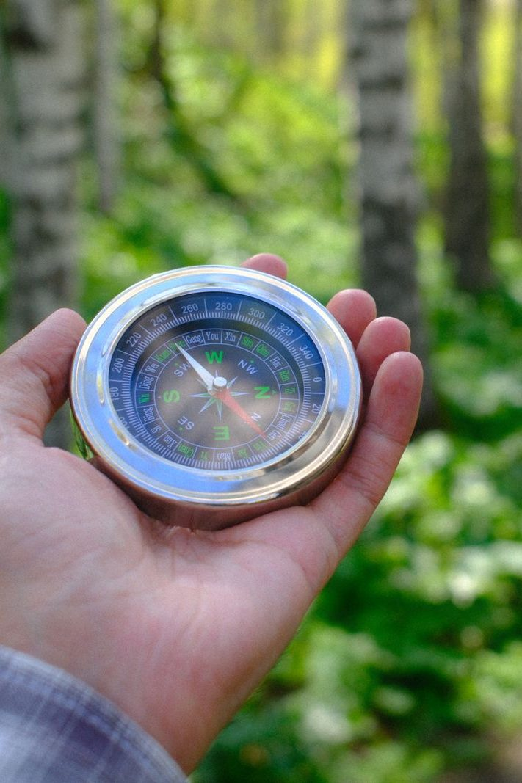
The Leader Feedback Round
• Two rounds, same as every session — the container holder first, then the content presenter: three things each
– “What I think went well tonight: ______”
– “What I’d do differently next time: ______”
– “If I were to teach tonight’s process to someone, I would tell them: ______”
• Then the room — the same two questions about tonight
• The leaders receive without defending — “thank you” is the whole response
149
Notes:
S11 · 8:24–8:28 · LEAD: BOTH LEADERS
BEATS: 1. Same round: leader's three answers first, then the room's two questions — two or three voices is plenty. 2. Receive without defending — 'thank you' is the whole response. 3. May be dropped if the room needs quiet; dropping it twice running goes to the team debrief.

Slide 14
Closing the Container + Aaronic Blessing
• We close the way we opened — the container, six steps:
1 Stand again — same circle, same posture as the open
2 One-word landing — compare it to your opening word
3 The one thing you are taking from tonight
4 The one practice — committed aloud, or modified to one you will actually keep
5 Blessings — specific, witnessed, short
6 Closing prayer — and the Aaronic blessing, spoken over each other, face to face
THE AARONIC BLESSING — NUMBERS 6:24–26
“The Lord bless you and keep you;
the Lord make his face to shine upon you, and be gracious to you;
the Lord lift up his countenance upon you, and give you peace.”
150
Notes:
S11 · 8:28–8:30 · LEAD: CONTAINER HOLDER
BEATS: 1. What was named in your pair is yours — some doubts quietly resolve, some deepen before they release; both are normal. If anything is heavier than today could hold, reach out. 2. Announce the road: quarter break now; The Return in January; then Week 13 turns outward to Mission, on toward the Rhythm week and the two commissionings. 3. Aaronic blessing. 'Keep one practice alive over the break — just one. See you in January, at The Return. Merry Christmas to every house in this room.'

Slide 15
Quarter 3
Mission & Rhythm
Weeks 12–17 · Six Wednesdays · The Return, Mission, the Rhythm and the Four Questions
151
Notes:
QUARTER 3 · pre-session · DIVIDER
On screen as families arrive — first evenings back after the Christmas break. Today is The Return: the open runs slow on purpose. Greet warmly at the door; nobody owes an explanation for the break.

